Slide 1


PHYSICS
COMPUTER SCIENCE & ENGINEERING
Presented by,
Group-08
SECTION – B11

Slide 2
TOPIC NAME:- EXAMPLES OF MOTION IN REAL LIFE

Slide 3

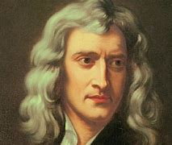
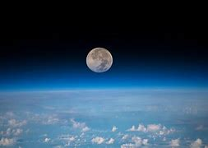
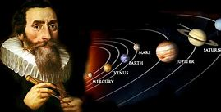
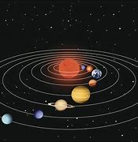



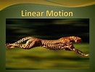
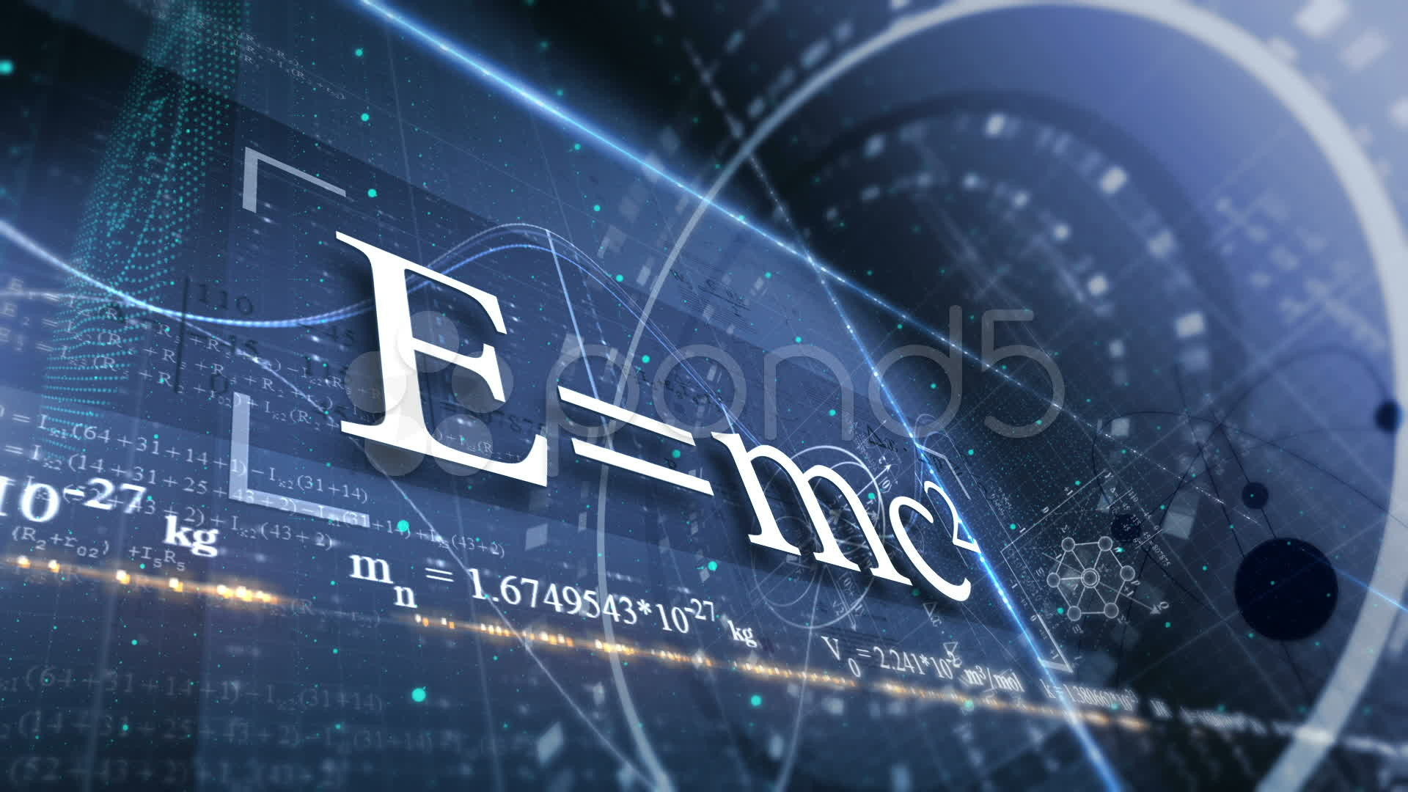



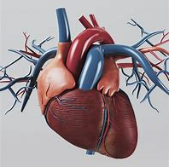
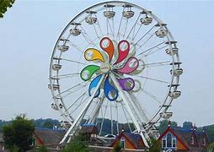
AGENDA
Background of the study
Types of Motion
Laws of Motion
Examples of Motion
Summary
Reference

Slide 4
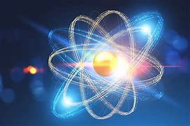
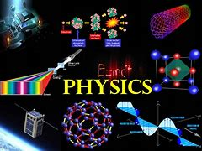
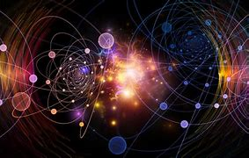
BACKGROUND OF THE STUDY
PHYSICS
FUNDAMENTAL BRANCH
IMPORTANT FACTOR OF PHYSICS

Slide 5


MOTION
CHANGING POSITION
EVERY OBJECT IN MOTION

Slide 6




EQUATIONS OF MOTION
$v =u+at$
$v^{2}=$
$u^{2}$+ 2as
${s=ut+\frac{1}{2} at}^{2}$

Slide 7
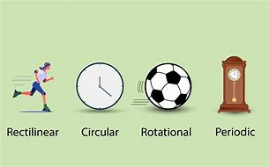
TYPES OF MOTION
Translational Motion
Circulatory Motion
Oscillatory Motion
Vibrational Motion
Linear Motion

Slide 8
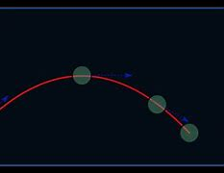
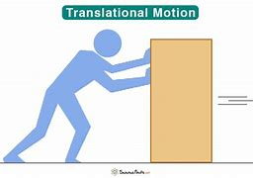
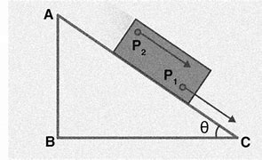
TRANSLATIONAL MOTION
A line or curve
Example: A car

Slide 9

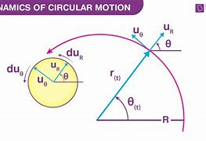
CIRCULATORY MOTION
About a particular point
Uniform or non-uniform
Example: Electric fans, hands
of clocks etc.

Slide 10
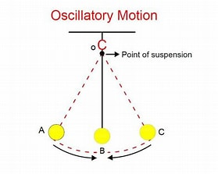
OSCILLATORY MOTION
Kind of periodic motion
Vibration is found
Example:
Beating of human heart &
Oscillation of Simple
pendulum

Slide 11
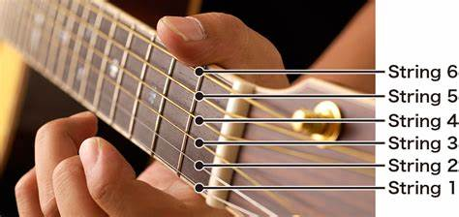
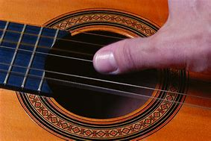
VIBRATIONAL MOTION
Reciprocating
Example:
Movement of strings
in GUITAR

Slide 12
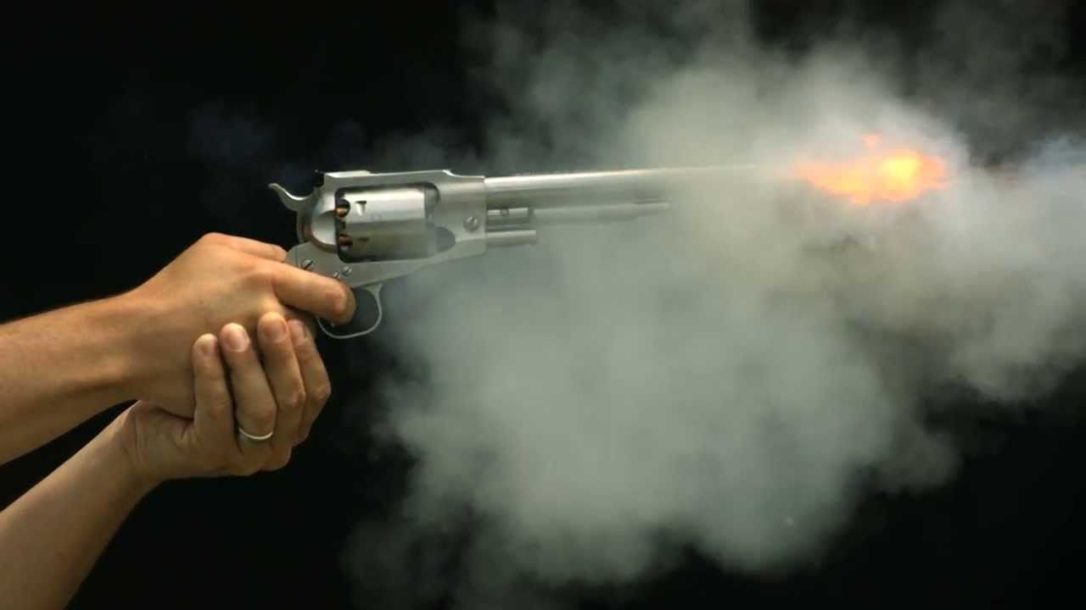
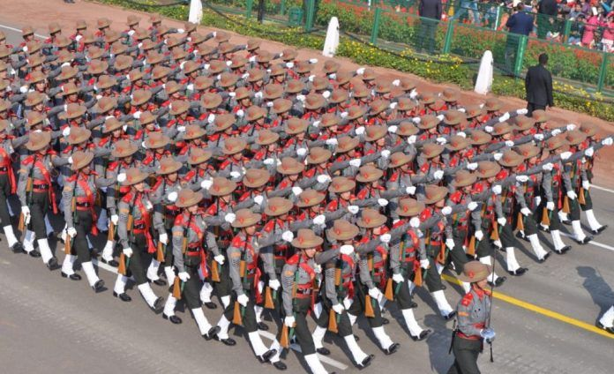
LINEAR MOTION
Rectilinear motion
Example:
Sliding a door
Firing a bullet
Parade

Slide 13
LAWS OF MOTION
First law of motion:
An object remains at rest or in motion
until and unless an external force is applied
Second law of motion:
Net force is equal to the product of multiplication of force and acceleration
Third law of motion:
Every action has an Equal and opposite reaction
Sir Isaac Newton(1643-1727)

Slide 14

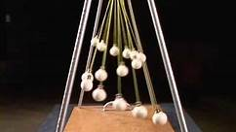
EXAMPLES OF MOTION
Sliding
Boomerang
Bowling
Planets around the sun

Slide 15
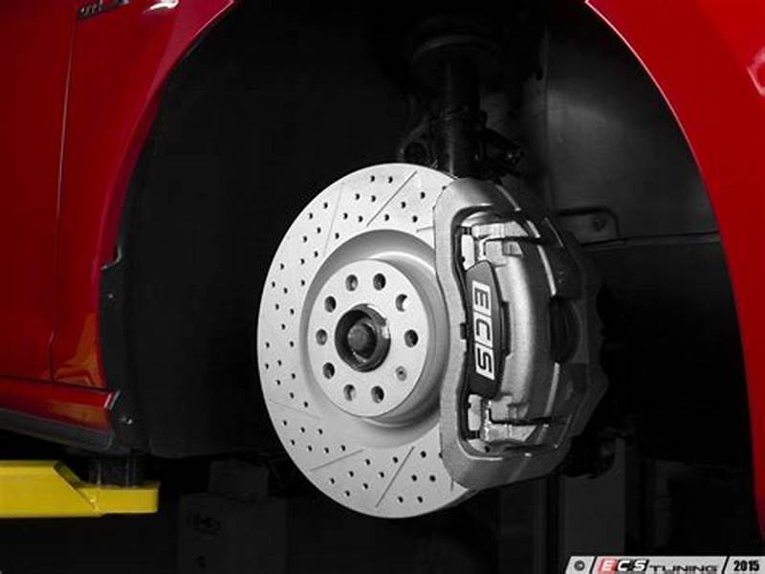
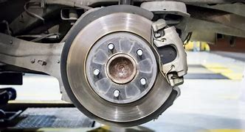
SLIDING
Arbitrary shape
Contact force
Example:
Motor vehicle tyre movement

Slide 16
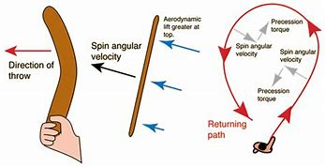



BOOMERANG
Thrown tool
Thrown vertically
Forward motion
and rotation

Slide 17




BOWLING
Popular sport
Centre of gravity
Symmetric & Asymmetric

Slide 18
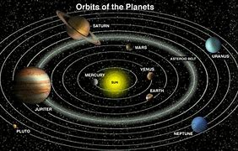
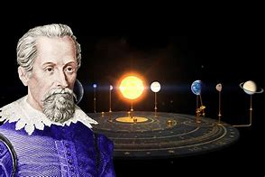
PLANETS AROUND THE SUN
In a circular path
Inertia & Gravitational attention
Kepler’s law

Slide 19
KEPLER’S LAW
First law:
Planets move in Elliptical orbits.
Second law:
Planet sweeps out equal areas in equal intervals of time.
Third law:
The square of planet’s orbital period is proportional to the cube of it’s major axis
JOHANNES KEPLER(1571-1630 )

Slide 20
SUMMARY
Discussion
Laws & Equations
Examples
Importance

Slide 21
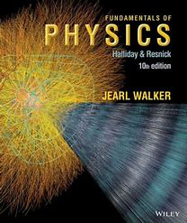
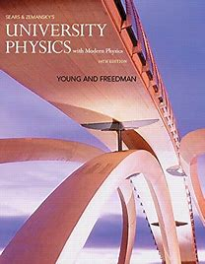
REFERENCE
Fundamentals of Physics
(Edition: 10th)
Written by
Halliday, Resnick and Walker
University Physics
(13/14th Edition)
Written by
Hugh D. Young and Roger A. Freedman

Slide 22
On behalf of group-08
THANK YOU

